Slide 1
BOOK YOUR CAP
PRESENTATION ON
Presented By
Ms.Ankita Satyavan Jagtap Roll No. 325
Ms.Pradnya Uttam Kamble Roll No. 338
Ms.Rutuja Narayan Patil Roll No. 353
Ms.Vaishnavi Vasant Kumbhar Roll No. 346
Guided By
Prof S.S.Nimbalkar
Department Of Computer
Engineering

Slide 2
INTRODUCTION
It is an online system through which customers can view available cabs; register the cabs, view profile and book cabs. Cab booking service is a major transport service provided by the various transport operators in a particular city. Mostly peoples use cab service for their daily transportations need
In the present situation, travel and transportation is becoming very popular amongst millions of travelers around the world. It is also one of the biggest demands of many people since it is compulsory for them to travel around the world. We need to travel from one place to another place in our daily life due to many factors. For making travels, you need to hire cab. Are you looking for the best step to have cab booking strategy? If yes, then you have arrived here at the right online portal where you could get the best cab services online.
The online cab company has different type vehicles for customers or a variety of vehicles on occasion.

Slide 3
PROBLEM STATEMENT
If You Want Go Somewhere,book Right Now!!

Slide 4
HOW WORK CAP BOOKING ARCHITECTURE

Slide 5
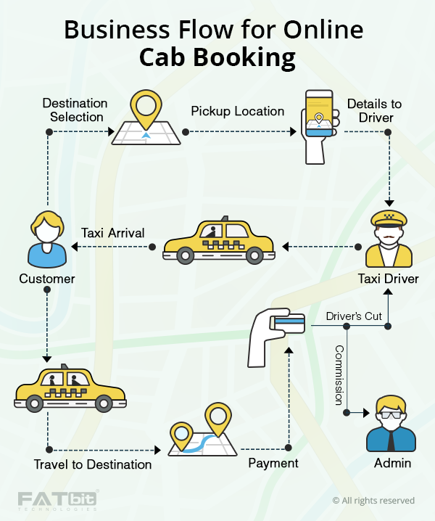

Slide 6
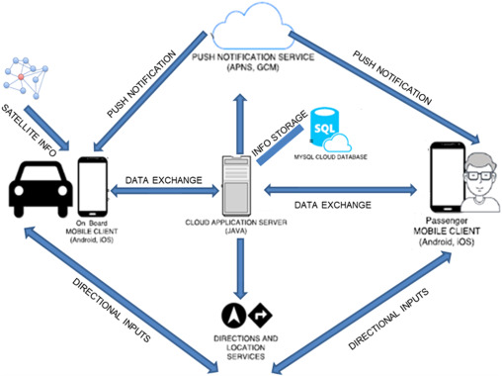

Slide 7
CONCLUSION
In This Mini Project, We Develop A Network TO BOOK A CAP IN ANY PLACE.
If They Book The Cap And They Mention Their Location Where To Go ,This Information Automatically Send To The Cap Driver.
Near Cap Deriver Reach That Place In 5-10min.
If People Reach That Place And He Pay The Rupees ,That Rupees Cut The Commission Of Admin.

Slide 8
REFERENCE
Book Cabs Nearby at Best Price | Hire Taxi Nearby Online at ...
https://book.olacabs.com
Ola Cabs offers to book cabs nearby your location for best fares. For best taxi service at lowest fares, say Ola!
Uber Taxi - Request Taxi Cabs with Uber App on your phones
https://www.uber.com › ride › ubertaxi
Request. Open the app and enter your destination in the "Where to?" box. Once you confirm your pickup and destination addresses are correct, select Uber Taxi .
Taxi Services In Pune, Cabs in Pune, Pune Cab Booking ...
https://www.makemytrip.com › Cabs
Get best Pune cab booking deals on Car Rentals from Pune to any city. ... charges, parking fees, entry fees, service tax and any other government-levied taxes.

